Slide 1
Wi-Fi:
Starspace 46 guest
Password:
Techlahoma

Slide 2
FreeCodeCampOKC.com
facebook.com/groups/free.code.camp.oklahoma.city
linkedin.com/groups/12086660
meetup.com/FreeCodeCampOKC
twitter.com/FreeCodeCampOKC

Slide 3
Thanks for joining us today! We're here thanks to volunteers, speakers, and Techlahoma.

Slide 4
What is Techlahoma?
non-profit volunteer-run organization
hosts 33 groups and 2 conferences
sponsors free local events
supports the grassroots tech community of Oklahoma

Slide 5
Techlahoma.org
meetup.com/pro/Techlahoma
twitter.com/Techlahoma
donate.techlahoma.org/membership

Slide 6
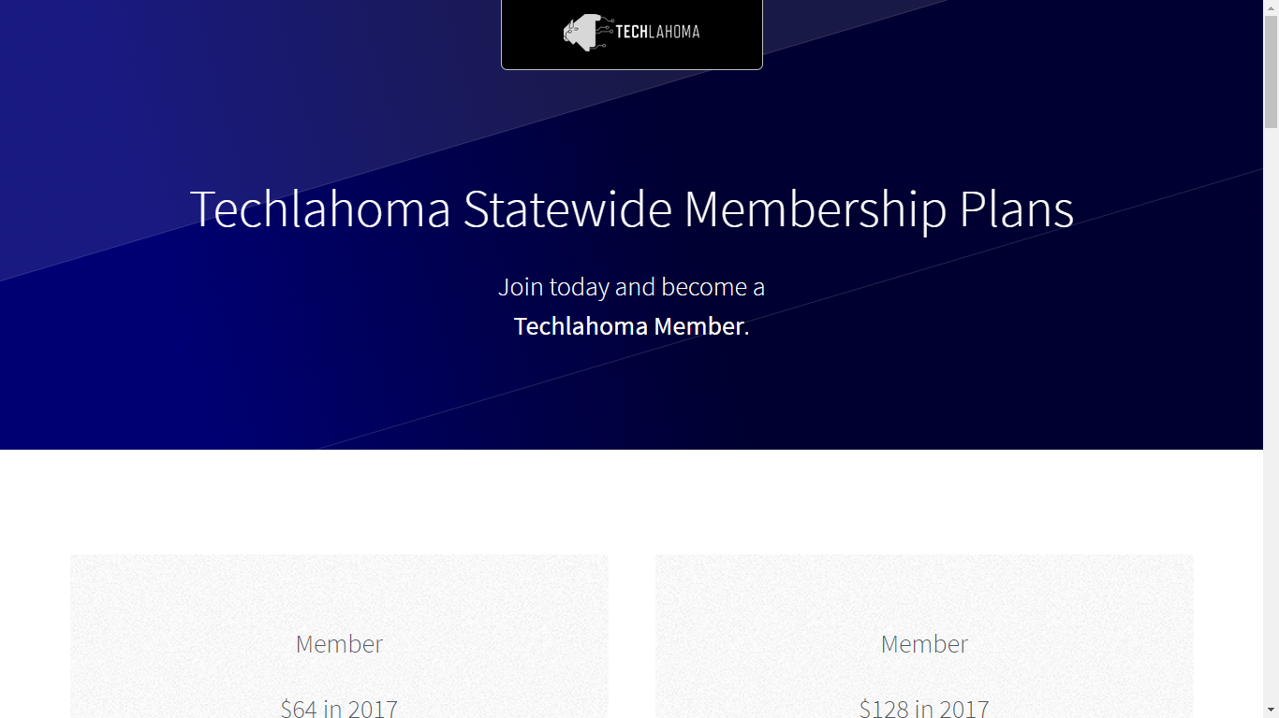
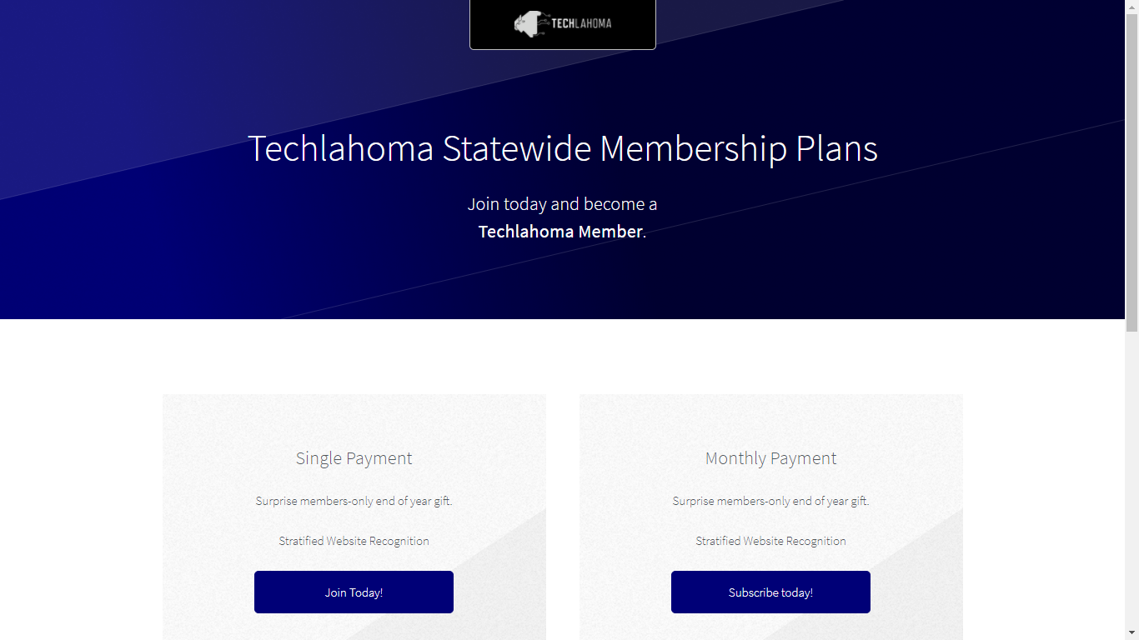

Slide 7
StarSpace46.com
starspace46.com/calendar-1
twitter.com/StarSpace46
Community membership $40/month

Slide 8
Twitch.tv/Techlahoma
Live streaming at StarSpace46
Subscribe with Amazon Prime
Techlahoma gets a small donation from Amazon

Slide 9
Slack
fccokc.com/slack
Channels for #freecodecamp, #jobs, #javascript, #design, and over 150 other topics

Slide 10
OKC SQL
Monday 1/15
6:00 - 8:00 pm
Where Do I Start? Training, Sandboxes, and Education
meetup.com/okcsql

Slide 11
OKC JavaScript
Tuesday 1/16
11:30 - 12:30
GraphQL from the Ground Up
meetup.com/okc-js

Slide 12
CocoaHeads OKC
Thursday 1/18
11:30 - 12:30
Wrasslin’ Complexity
meetup.com/cocoaheads-okc

Slide 13
DevOps OKC
Friday 1/19
11:30 - 12:30
Lightning Talks
meetup.com/devopsokc

Slide 14
Free Code Camp OKC
Sunday 1/21
2:00 - 3:00 pm
Intro to Express (Speaker Needed)
meetup.com/freecodecampokc

